Slide 1

Web Development 1
© Hugh McCabe & Matt Smith 2008-2015
Lecture 1d
Create a simple page step-by-step

Slide 2
Introduction
This week we are going to work through creating a simple web page step by step.
At the end of the lecture you should:
Have a good feel for how HTML mark-up works
Seen how browsers interpret HTML documents
Learned the basic structure of a HTML document
Have seen a style sheet in action

Slide 3
A Simple Web Page, Step by Step
Follow these steps:
Start with raw text content: raw text added to an “.html” file
Give the document HTML structure: learn about HTML elements and how they give the document it’s structure
Identify BLOCK level text elements: describe the content using appropriate HTML tags
Identify INLINE text elements: describe the content using appropriate HTML tags
Add an image
Change the look with a style sheet

Slide 4
Step 1: Start with Content

Slide 5
Step 1: Start with Content
Suppose we type the following text into a text file.
Black Goose Bistro
The Restaurant
The Black Goose Bistro offers casual lunch and dinner fare in a hip atmosphere
Catering
You have fun … we'll handle the cooking. Black Goose Catering can handle events from snacks for bridge club to elegant corporate fundraisers.
Location and Hours
Seekonk, Massachusetts;
Monday though Thursday 11am to 9pm, Friday and Saturday, 11am to midnight

Slide 6
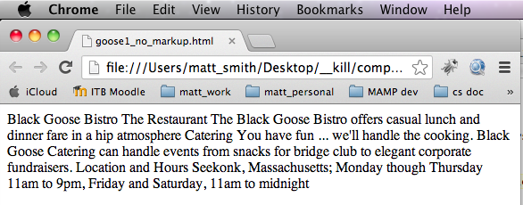
Step 1: Start with Content
If we save the file as index.html and open it in a web browser we will see something like this:

Slide 7
Step 1: Start with Content
This doesn’t look so great.
Firstly all the text runs together in one block.
This is because the browser ignores line breaks in the source (HTML) document.
Secondly there is no structure to the page.
Even though there were clear paragraphs and headings and so on intended, the browser was unable to pick up on this.
This is where using HTML mark-up to add structure comes in.

Slide 8
Step 2: Give the Document Structure

Slide 9
Step 2: Give the Document Structure
We have our text saved in the file index.html, let’s now start marking it up.
First thing is look are HTML elements
The diagram below is a generic HTML element.
Content
(text or other HTML elements)
Closing tag
(starts with a /)
Opening tag
<element name>
Content here
</element name>
Example:
<h1>
Black Goose Bistro
</h1>

Slide 10
ASIDE: always (forward) slash for the web
In web languages it is ALWAYS (forward) slash /
NEVER backslash \
☺
☹
</element name>
Closing tag
(starts with a /)
</h1>

Slide 11
Tags declare elements – they ‘mark-up’ content
Elements are identified by tags in the HTML source.
A tag consists of element name within angle brackets
E.g. <p>
Browser not display anything within angle brackets
Element name appears in opening tag,
again in closing tag preceded by a forward slash "/"
closing tag works like an “off” switch for the element.
tags surrounding the content are called mark-up
element consists of its mark-up and its content
Coding style for this module:
Always write element names in lower-case (not UPPER CASE)

Slide 12
Step 2: Give the Document Structure
Basic document structure
HMTL5 documents start with the html doctype
HTML documents have both a head and a body.
The head contains descriptive information about the document itself e.g.
its title
the style sheet it uses
other types of “meta” information, such as character set
The body contains the actual content that is displayed in the window.
The slide overleaf shows the basic “skeleton” of a HTML document.

Slide 13
1
<!doctype html>
<html lang="en">
<head>
<meta charset="utf-8">
<title> Title here </title>
</head>
4
3
2
5
<body>
Web page content here
</body>
6
</html>
1
4
character encoding (just always include this line…)
Identifies document contents as HTML5
Identifies beginning of HTML content (and webpage content will be in English)
5
Webpage title is required
(becomes bookmark/browser tab)
2
6
Body contains the content to be seen in browser window
3
Head provides into about the doc

Slide 14
Step 2: Give the Document Structure
First line declares that this is an HTML 5 document:
<!doctype html>
entire document contained within html element
called the root element and contains all other elements
The head comes next
contains title element
Every document must have a title (used for bookmarking and browser tab/window titles)
The body element comes after head
contains everything to be displayed in browser window
“if you want user to see it in browser window, then put it in the body”

Slide 15
Step 2: Give the Document Structure
<!doctype html>
<html lang="en">
<head>
<meta charset="utf-8">
<title> Black Goose Bistro </title>
</head>
<body>
Black Goose Bistro
The Restaurant
The Black Goose Bistro offers casual lunch and dinner fare in a hip atmosphere
Catering
You have fun ... we’ll handle the cooking. Black Goose Catering can handle events from snacks for bridge club to elegant corporate fundraisers.
Location and Hours
Seekonk, Massachusetts;
Monday though Thursday 11am to 9pm, Friday and Saturday, 11am to midnight
</body>
</html>

Slide 16
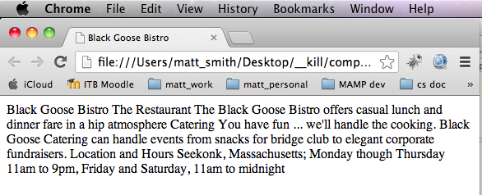
Step 2: Give the Document Structure
This is what it looks like in a web browser.
NOTE: Always test in Google CHROME browser

Slide 17
Not much has changed here.
Except for one thing …
Can you spot it?

Slide 18
Not much has changed here.
Except for one thing …
Can you spot it?

Slide 19
Element (descendent) “tree” Graphically shows ‘parent’ (and sequence)
html
head
body
meta
title
Parent “contains” children
For this document the structure is:
html element is “parent” of everything – it “contains” everything
Inside html first comes “head” then “body”
Inside “head” first comes “meta” then “title”

Slide 20
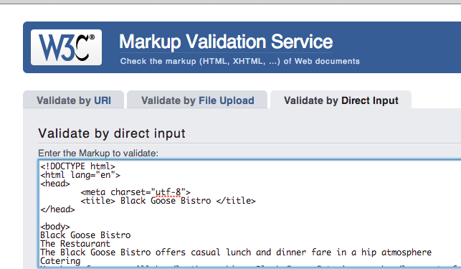
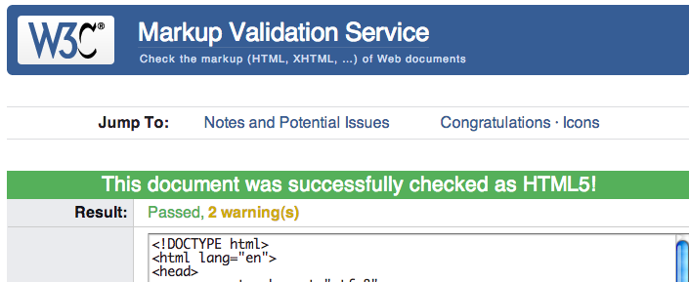
Let’s test if the structure is correct - VALIDATE
We’ll learn more about validation in a minute…

Slide 21
Step 3: Identify BLOCK level Text Elements

Slide 22
Step 3: Identify BLOCK level Text Elements
Next step to mark up text element BLOCKS in body of document using elements like:
h1 : heading 1 (most important kind of heading)
h2 : heading 2 (subheadings)
p : paragraph
Some things important to understand before we start.
Purpose of marking-up content is to provide meaning and structure to content
NOT intended to provide instructions as to how it should look

Slide 23
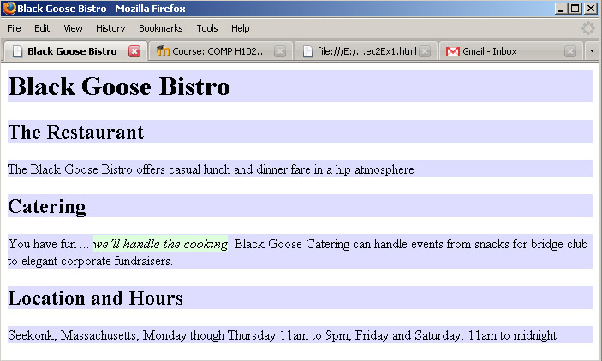
Step 3: Identify Text Elements
BLOCK LEVEL elements on a blue background
INLINE elements on a green background

Slide 24
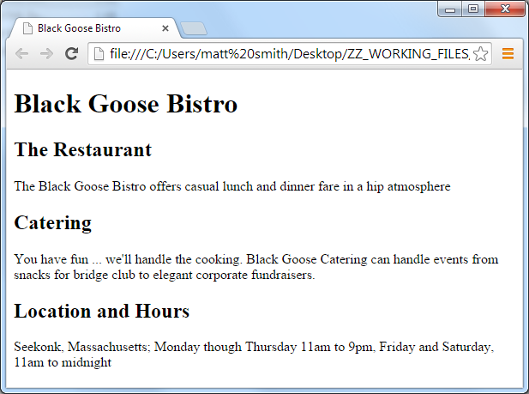
Step 3: Identify BLOCK level Text Elements

Slide 25
Step 3: Identify BLOCK level Text Elements
Known as semantic mark-up.
For example
first heading level on page should be marked up as h1 because it is the most important heading, not because you want it bigger than the rest
In addition to providing meaning mark-up also defines structure
The way elements follow each other, or nest within one another, create relationships between them
This is basis upon which presentation instructions can be added with CSS

Slide 26
Step 3: Identify Text Elements
<!doctype html>
<html lang="en">
<head>
<meta charset="utf-8">
<title> Black Goose Bistro </title>
</head>
<body>
<h1> Black Goose Bistro</h1>
<h2> The Restaurant</h2>
<p> The Black Goose Bistro offers casual lunch and dinner fare in a hip atmosphere</p>
<h2> Catering</h2>
<p> You have fun ... we'll handle the cooking. Black Goose Catering can handle events from snacks for bridge club to elegant corporate fundraisers.</p>
<h2> Location and Hours </h2>
<p> Seekonk, Massachusetts;
Monday though Thursday 11am to 9pm, Friday and Saturday, 11am to midnight </p>
</body>
</html>

Slide 27
Element (descendent) tree
html
head
body
meta
title
h1
h2
p
h2
p
h2
p

Slide 28
Step 4: Identify INLINE Elements

Slide 29
Step 4: Identify INLINE Text Elements
Next step to mark up INLINE text elements in body of document using elements like:
em : emphasised text
Other examples of inline elements include
Images are a special kind of inline element
Hypertext or mailto links
special letters / characters
strongly important words or letters
Can use CSS to choose how to highlight such important/special text

Slide 30
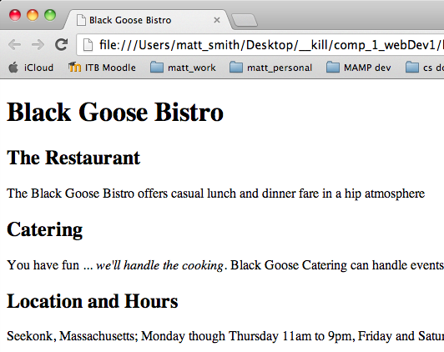
Step 4: Identify INLINE Text Elements

Slide 31
Step 3: Identify Text Elements
<!doctype html>
<html lang="en">
<head>
<meta charset="utf-8">
<title> Black Goose Bistro </title>
</head>
<body>
<h1> Black Goose Bistro</h1>
<h2> The Restaurant</h2>
<p> The Black Goose Bistro offers casual lunch and dinner fare in a hip atmosphere</p>
<h2> Catering</h2>
<p> You have fun ... <em> we'll handle the cooking</em>. Black Goose Catering can handle events from snacks for bridge club to elegant corporate fundraisers.</p>
<h2> Location and Hours </h2>
<p> Seekonk, Massachusetts;
Monday though Thursday 11am to 9pm, Friday and Saturday, 11am to midnight </p>
</body>
</html>

Slide 32
Element (descendent) tree
html
head
body
meta
title
h1
h2
p
h2
p
h2
p
em

Slide 33
Hang on minute – WHY are <em> elements styled in italic?
We haven’t added a CSS style sheet yet?
DEFAULT STYLES …

Slide 34
DEFAULT STYLES
The browser automatically assigns some presentation
E.g.
it makes h1 elements bigger than h2 elements
It displayed <em> elements as italics
This is because:
browser has a built-in default style sheet that it uses if not told any different
Roughly same from browser to browser, but NOT good idea to rely on default styles
If you want high quality looking web pages
goods sites remove default styling, define all their own …

Slide 35
Step 5: Add an Image

Slide 36
Step 5: Add an Image
Let’s look at how to add an image using the img element.
A good opportunity to introduce two more important concepts:
empty elements
attributes

Slide 37
EMPTY elements
1. Empty Elements
All elements seen so far follow same pattern
i.e. the element consists of
start tag <h1>
some content I am a heading
closing tag </h1>
However, some elements that do NOT have content
These elements provide DIRECTIVES to browser
E.g. put something here in the page
They are called empty elements

Slide 38
EMPTY elements
Image element (img) is an example of an empty element
Image element tells browser to place a particular image on the page
It is a DIRECTIVE to the browser
it does not mark-up text – there is no content
And so no need for a closing tag, since “nothing in the sandwich”
Other examples include:
horizontal rule (hr).
line break (br)
Empty elements consist of a single tag e.g.
<br>

Slide 39
Attributes
2. Attributes
An <img> tag is not that useful by itself.
How does browser know which image to use?
Attributes are information that clarify or modify and element
For the img element
attribute src (for “source”) is required
tells browser location of image file to insert into page
Before looking at how to use the img tag let’s look at how attributes are used in general.

Slide 40
Step 5: Add an Image
The syntax for attributes is as follows:
<element attribute=“value”>
Content here
</element>
For an empty element it would be:
<element attribute=“value” >
Here’s an example of using the img tag:
Tag name
Attribute value
Attribute value
Attribute name
Attribute name
<img src=“images/bird.jpg” alt =“picture of bird”>

Slide 41
Step 5: Add an Image
Attributes:
Only appear in opening tags
Element can have several attributes
Atttributes take values, which follow the equals (=) sign
Values can be words, numbers, URLS .. depends
Usually put values in double quotation marks ("value")
Some attributes required, many are optional
We can now add an image to the Black Goose Bistro page.
Before the h1 tag insert:
<img src="images/blackgoose.gif" alt="Goose logo">

Slide 42
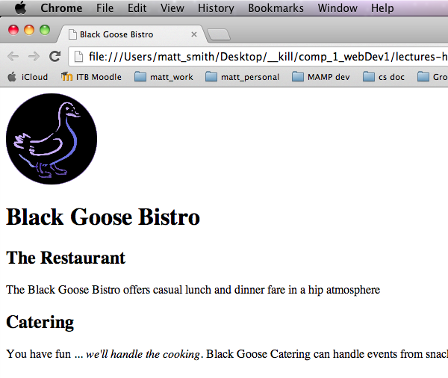
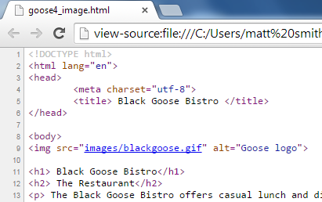
Step 4: Add an Image

Slide 43
Element (descendent) tree
html
head
body
meta
title
img
h1
h2
p
h2
p
h2
p
em

Slide 44
Step 6: Change the look with a style sheet

Slide 45
Step 6: Change the look with a style sheet
What if we want to change how the web page appears in the browser?
In other words, control the presentation.
This is where Cascading Style Sheets (CSS) come in.
We’ll look at these much more detail in later weeks
For now we will just present some style rules without worrying about trying to understand how they work.
Next slide shows some CSS rules in text file: goose.css
Following slides show HTML markup to tell browser to use the rules in file "goose.css", and what browser displays…

Slide 46
Step 5: Change the look with a style sheet
body {
background-color: #C2A7F2;
font-family: sans-serif;
}
h1 {
color: #2A1959;
border-bottom: 2px solid #2A1959;
}
h2 {
color: #474B94;
font-size: 1.2em;
}
h2,
p {
margin-left: 120px;
}

Slide 47
In the HTML head tell browser to import style rules …
<!DOCTYPE html>
<html lang="en">
<head>
<meta charset="utf-8">
<title> Black Goose Bistro </title>
<style>
@import "css/goose.css";
</style>
</head>
<body>
Black Goose Bistro
The Restaurant
The Black Goose Bistro offers casual lunch and dinner fare Etc....

Slide 48
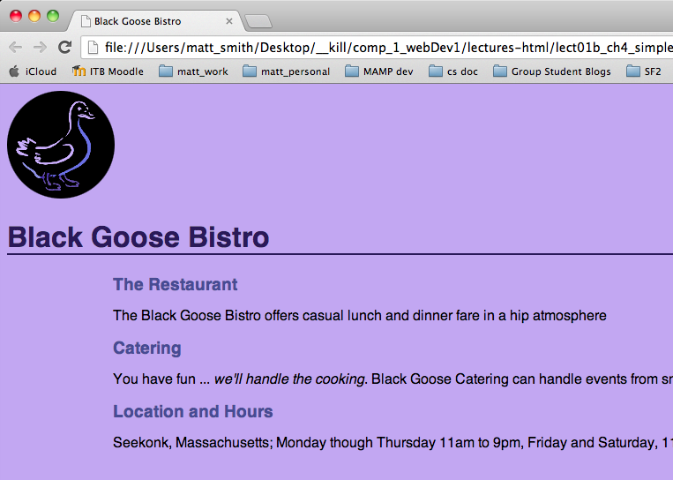

Slide 49
W3C Validation service

Slide 50
W3C – who are they?
W3C international organisation publishing web standards
Versions of HTML, CSS, JavaScript etc.
URL: w3c.org

Slide 51
W3C Validation service
Your CSS and HTML can be grammar-checked by the W3C validation service
For free !
For HTML Ensure you include DOCTYPE as first line
So your file being validated against HTML version 5 …
URL for HTML validation: validator.w3.org
URL for CSS validation: jigsaw.w3.org/css-validator/

Slide 52
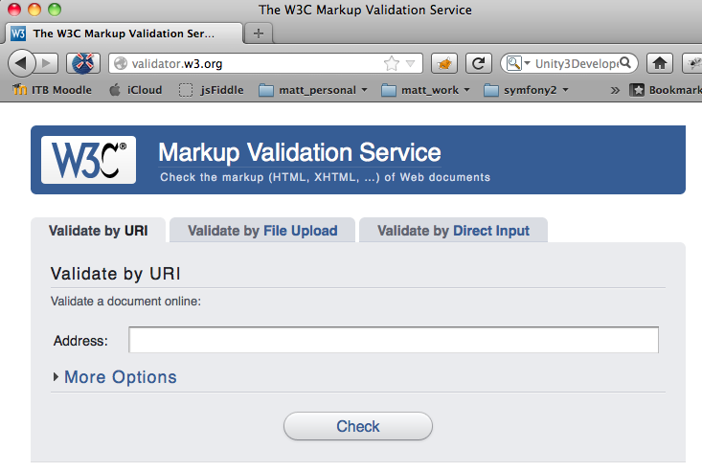

Slide 53
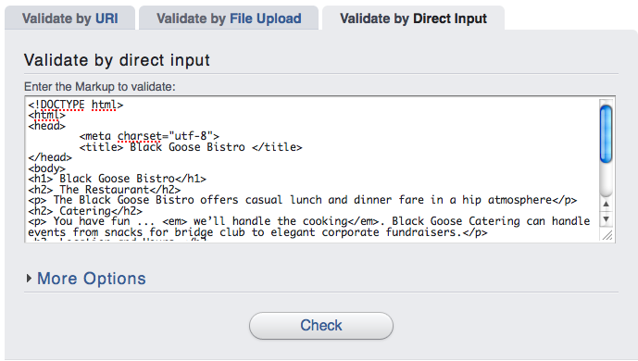
Copy text and PASTE into Direct Input tab …
Paste your code in here …

Slide 54
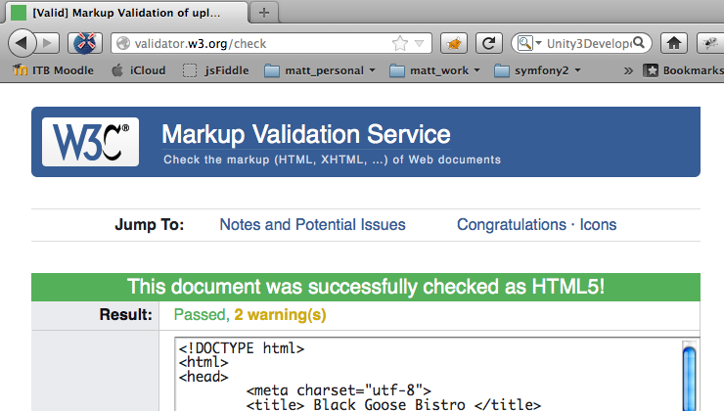
GREEN = SUCCESS!

Slide 55
You may get just 2 ‘warnings’ if you code is correct
Warning 1
The HTML 5 standard is still being finalised, so first warning is simply that HTML 5 results are indicative
Although for this module all the HTML 5 we’ll learn is very unlikely to change in the future …
Warning 2
Since you copied and pasted code, the validator cannot check the actual way your text file has been saved and ‘encoded’
You can check this with the FILE UPLOAD validation method if you wish

Slide 56
Website project LIFE CYCLE …

Slide 57
YOUR website development life cycle - print and stick on your door !
Start with raw text content (and image files)
Save text into “.html” files: NOTE: do NOT place html files in subfolders
Organise your website folder structure (/css, /images)
Markup with HTML
Add HTML document structure (doctype, head/body)
Markup BLOCK level text elements (h1, h2, p, hr, lists)
Markup INLINE text elements
Add in images and simple links
Markup page level elements (header/footer/divs/sections)
Markup navigation lists
Define presentation with CSS style sheet(s)
Create .css files in your /css folder, and add @imports to <head>
Write your style rules for text elements / page layout / nav bars
HTML validate
CSS validate
validate your HTML and CSS files continuously as you write them

Slide 58
YOUR website development life cycle - print and stick on your door !
Quality assurance
Are all resources loaded?
Does EVERY image display? Does EVERY link work correctly?
Evaluate site with human ‘users’ and improve. E.g.:
Can user find items easily? Can user navigate easily?
Can user get to home page / site map?
Do they know which site / page they are on?
Ensure all project requirements have been met
Have you delivered EVERYTHING in the spec?
Re-validate all HTML and CSS documents
YES! Do this all again BEFORE you submit project
Resources check
Usability testing
Check all criteria
HTML validate
CSS validate

Slide 59
Summary and Conclusions

Slide 60
Conclusion: some IMPORTANT concepts
The role of mark-up
HTML document structure
HTML elements
Tags
attributes
Empty elements
BLOCK LEVEL vs. INLINE elements
Element descendent trees
VALIDATION of your code – QUALITY ASSURANCE

